Slide 1

Financial Performance Analysis :
"Analyzing Sales, Discounts, and Profitability Trends by Segment, Product, and Country"

Slide 2

Objective
The goal of this Tableau project is to analyze financial performance across different countries, products, and time periods, using key financial metrics such as sales, profit, cost of goods sold (COGS), and discounts.
Exploratory Goals :
Which countries generate the highest and lowest sales and profit
How do sales and profit vary over time
Find relationship between gross sales and discount rates
How do sales differ across product categories and discount bands

Slide 3

Data Overview
This dataset contains financial performance data with the volume of 700 records(rows) and 16 columns including sales, profit, discounts, and cost details across various countries, product segments, and time periods.
Key Columns / Variables :
Segment : The market segment or customer group.
Country: The geographical region where the sales occurred.
Product: Specific products sold.
Units Sold: Quantity of items sold.
Manufacturing Price and Sale Price: Cost and selling price of products.
Gross Sales, Discounts, Sales, COGS, and Profit: Key financial metrics, including costs, revenue, and profit.

Slide 4
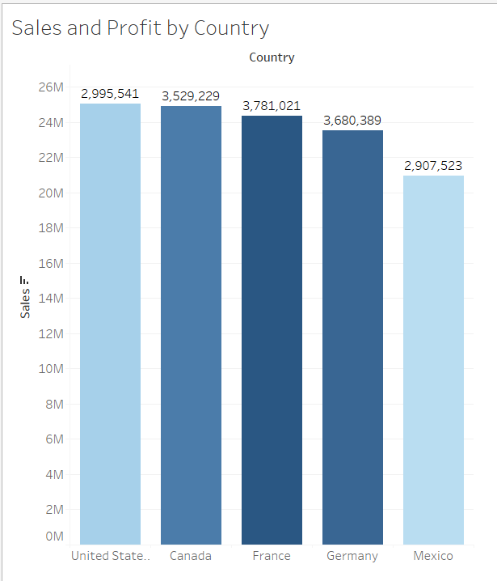
Countries generating the highest and lowest sales & profit
The given bar chart shows the sales and profit by country where the bar shows the sales and the colour shading shows the profit
Analysis:
Sales Analysis
United States have the highest sales and Mexico have the lowest sales among other countries as the bar of United State is largest and bar of Mexico is smallest.
Profit Analysis
The colour shading shows the profit as the darker shades shows higher profit and lighter shades shows the lesser profit so it is clear that France is the highest profit generating country and Mexico is the lowest profit generating country among other Countries.

Slide 5
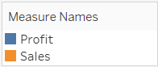
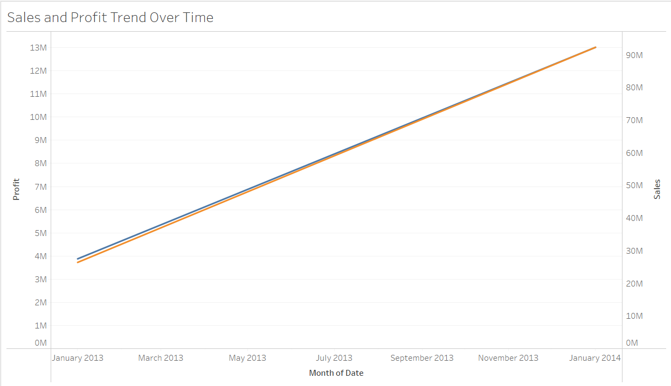
Sales and profit over time
The given line chart shows the sales and profit over time where the Blue line is profit and Orange line is sales.
Analysis
Overall Trend :
Both Profit and Sales shows a consistent upward trend over time. This indicates a positive growth trajectory in both revenue and profitability over the analyzed period.
Parallel Growth :
The lines for sales and profit are closely aligned, suggesting that as sales increase, profit also increases proportionally. This implies effective cost management and stable profit margins.

Slide 6
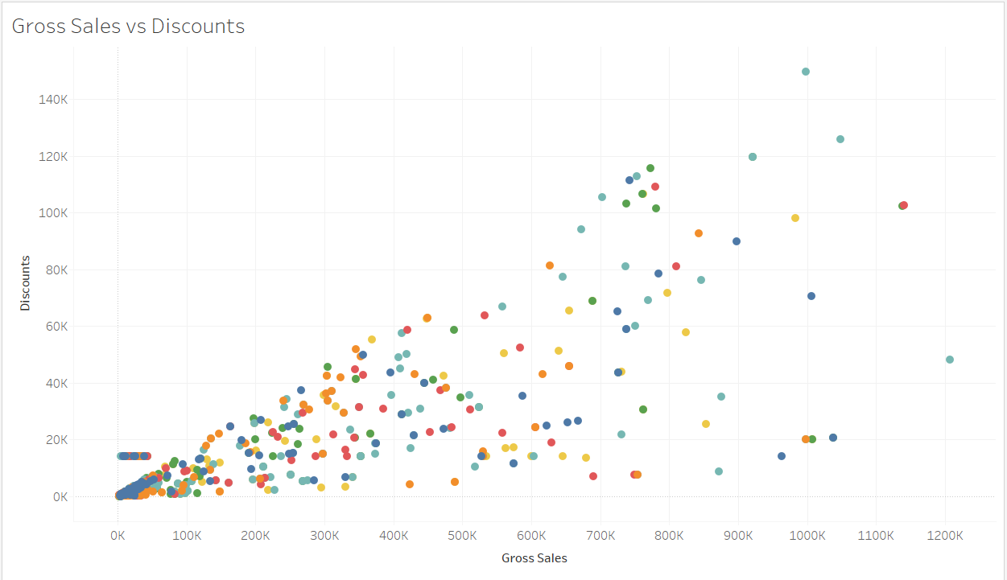
Relationship between gross sales and discount rates
This Scatter plot shows the relation between Gross Sales and Discounts and the different colours shows the types of products.
Analysis
Positive Correlation:
The plot shows an upward trend, giving a positive correlation between Gross Sales and Discounts. As gross sales increase, the discount amounts tend to increase as well, which could imply that higher sales volumes often come with larger discounts.

Slide 7
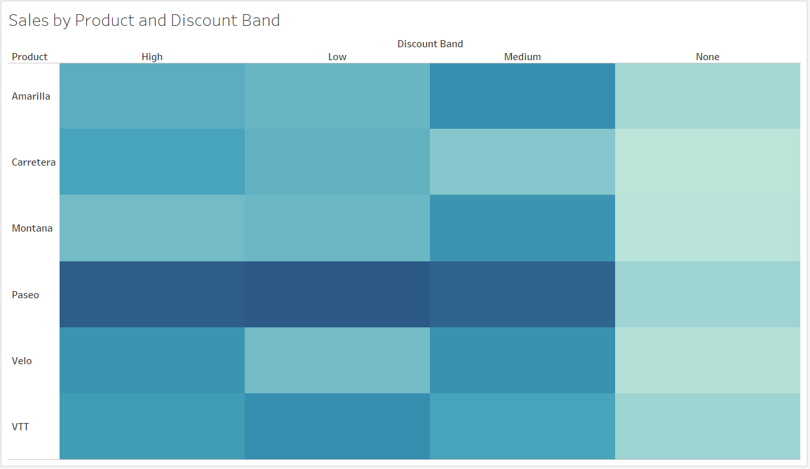
How sales differ across product categories and discount bands
The Heat Map shows the sales across different Discount Bands the darker shades represents the higher sales and lighter sales represents the lower sales.
Analysis
High Sales : The Paseo product shows consistently high sales across all discount bands, suggesting strong demand regardless of discount level.
Effect of No Discount : Many products like Amarilla and Montana show lighter shades in the "None" discount band indicating lower sales when no discount is applied. This suggests that offering even a small discount could boost sales for these products.

Slide 8
Recommendation
Implement a Tiered Discount Strategy by Product
Low Discounts for High-Performing Products: Products like Paseo and Velo, which show strong sales even with minimal discounts, should have limited or low discounts to protect profit margins.
Increased Discounts for Discount-Sensitive Products: Apply moderate discounts to products like Amarilla and Montana to stimulate demand, as they show increased sales with even slight discounts.
Focus Inventory and Marketing Efforts on High-Performing Products
Prioritize High-Performing Products: Products like Paseo and Velo show strong sales across all discount bands. Ensure these are always well-stocked and consider targeted marketing campaigns to maximize their sales potential.
Analyze Product-Specific Discount Bands: Use product-level insights to apply discounts more strategically. For instance, Amarilla and Montana benefit more from medium and high discounts, suggesting that promotions for these products should emphasize these discount ranges.
Refine Pricing Strategy Based on Gross Sales vs. Discounts Relationship
Reduce Discounts in High-Gross Sales Segments: For products or orders that already achieve high gross sales, avoid high discounts as they do not yield proportionate revenue increases. This can help in maintaining overall profitability.
Leverage Small Discounts for Price-Insensitive Products: For products that show limited sensitivity to discounts, offer minimal or no discounts. This strategy will help capture additional revenue without significant price reductions.

Slide 9
Summary
The analysis reveals that certain countries and products significantly drive overall sales and profitability, with some regions and items showing strong performance even with minimal discounts. A positive correlation between gross sales and discounts suggests that discounting is an effective strategy to boost sales volume; however, careful optimization is needed to maintain profit margins. The findings recommend a focused approach: prioritize investment in high-performing countries and products, refine discount strategies to enhance returns, and ensure inventory alignment with demand patterns. Overall, by leveraging these insights, the business can enhance its revenue potential while balancing profitability across regions and product lines.

Slide 10
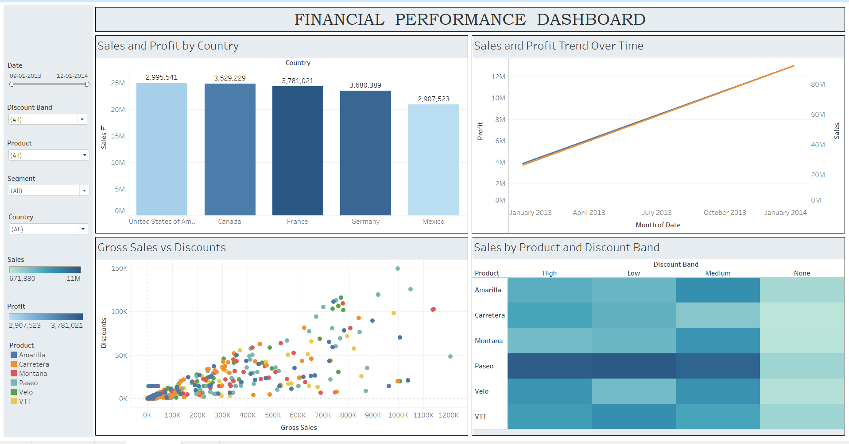

Slide 11
Thank you

